Slide 1



Git and GitHub
Version Control Systems
SoftUni Team
Technical Trainers
Software University
https://softuni.bg

Slide 2

Table of Contents
Software Configuration Management and Source Control Systems
Vocabulary: Clone a Repo, Commit a Changeset, Push the Changes, Pull Changes, Merge Changes
Introduction to Git
Working with git, Git Bash, and TortoiseGit
Introduction to GitHub
Create a Repo, Clone, Commit, Push, Conflicts

Slide 3
Have a Question?
sli.do
#fund-common

Slide 4
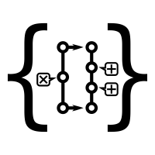


Source Control Systems: Lesson Summary
Source control systems keep the source code (+ other project assets) in a shared repository
Developers can clone a repository, pull the latest version, commit & push local changes, view the change logs, etc.
Git is the most popular source control system
Other version control systems: SVN, TFS, Perforce
GitHub is the #1 site for Git project hosting
Git hosting + issue tracker + project tracker + build system
4
Notes:
Source control systems are critical for the software development process and coding in a team.
Virtually all major companies and software development teams use source control systems.
There are no exceptions: if you are a developer, you should know how to work with source control systems like Git and SVN.
"Source control" or "version control" is a concept in software engineering, used every day by millions of developers.
Source control systems keep the source code and other project assets in a shared repository,
available through the Internet or in a local environment.
Developers can clone a repository, pull the latest version of the code,
commit & push the local changes, merge the conflicting changes
and collaborate with the other developers.
They can also view the change logs (the project history),
compare different versions of the same file and restore previous versions,
branch the code into separate line of development and many others.
Git is the most popular source control system in modern software development.
It is distributed source control system, a very powerful tool for version control
and team collaboration at the source code level.
Git is the system behind GitHub, the largest software project hosting portal in the world.
Other popular version control systems are: SVN, TFS and Perforce.
GitHub is the #1 site for Git project hosting and developer collaboration.
It hosts almost all major open-source projects from the software industry.
GitHub provides Git hosting + issue tracker + project tracker + build system
+ many other tools for developers and team collaboration.
Millions of developers use GitHub every day to
sync and commit source code and documentation,
track, review and control changes in the code,
branch and merge code,
manage, discuss and track issues,
manage project plans, tasks and schedule,
build, test and deploy projects.
Developers today should be familiar with Git and GitHub.
At SoftUni we teach the concepts of source control systems, and how to use Git and GitHub, early in our end-to-end educational program for software developers, to enable students to create a portfolio of practical projects, which helps them to start their first developer job.

Slide 5
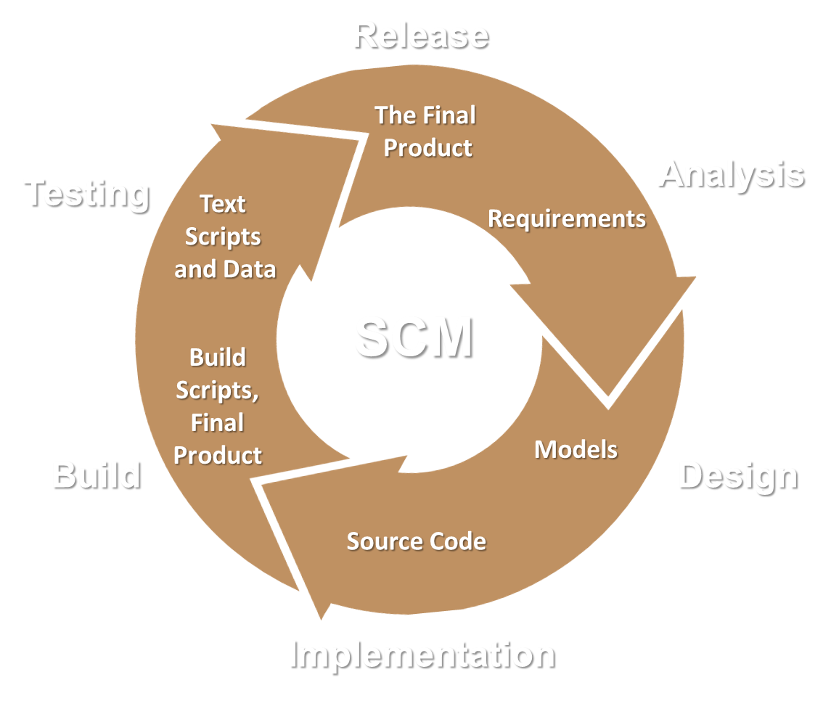
Software Configuration Management
Working on Shared Code: Source Control Systems

Slide 6
Software Configuration Management
Version control ≈ Software Configuration Management (SCM) ≈ source control system
A software engineering discipline
Consists of techniques, practices and tools for working on shared source code and files
Mechanisms for management, control and tracking the changes
Defines the process of change management
Keeps track of what is happening in the project over time
Solves conflicts in the changes

Slide 7
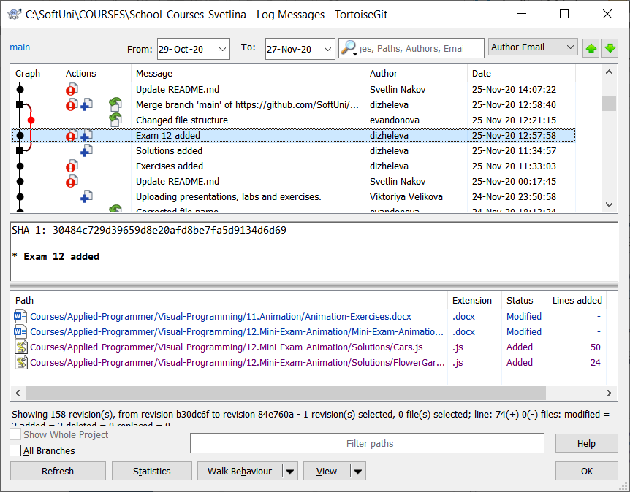
Change Log
Version control systems keep their own change log (version history). It shows:
Who?
When?
Why?
What had been changed?
Old versions could be restored

Slide 8
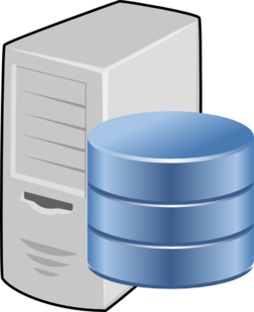
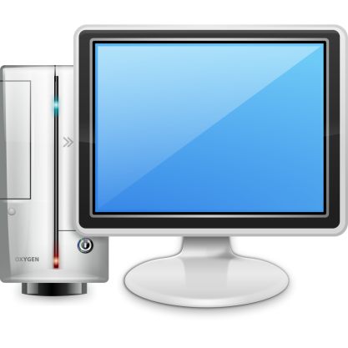
Vocabulary: Repository (Repo)
Repo holds the project in a remote server
Remote
Local

Slide 9
Vocabulary: Clone
Clone == download a local copy of the remote project
Remote
Clone
Local

Slide 10

Vocabulary: Commit
Commit == saves a set of changes locally
Remote
Commit
Local

Slide 11


Vocabulary: Sync (Pull / Push)
Pull – take and merge the changes from the Remote
Push – send local changes to the Remote
Remote
Merge
Push
Pull
Local
Conflict

Slide 12
Vocabulary: Branch
master
master
custom-branch

Slide 13
Vocabulary: Merge Branches
Conflict
master
master
custom-branch

Slide 14





Example: Branches

Slide 15
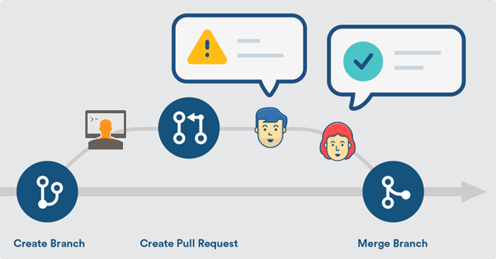
Pull Requests: The Code Review Process

Slide 16

Git
World's #1 Source Control System

Slide 17

What is Git?
Git == distributed source-control system
The most popular in the world
Free, open-source software
Works with local and remote repositories
Git bash – command line interface for Git
Runs on Linux, macOS and Windows (msysGit)
https://git-scm.com

Slide 18
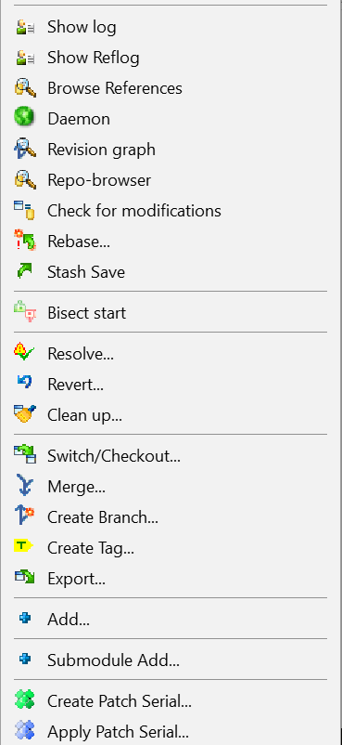
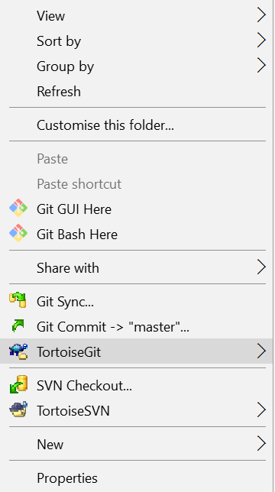
Using Git
Console-based Git client
git, Git Bash
Windows GUI client – TortoiseGit
https://tortoisegit.org/download
Visual Studio / Eclipse plug-ins
GitHub Desktop client
https://desktop.github.com

Slide 19
Installing Git
Git installation on Windows: Git for Windows (msysGit)
https://git-scm.com/downloads
Options to select (they should be selected by default)
"Use Git Bash Only"
"Checkout Windows-style, Commit Unix-style Endings"
Git installation on Linux:
sudo apt-get install git

Slide 20
Basic Git Commands (1)
Cloning an existing Git repository
Fetch and merge the latest changes from the remote repository
Preparing (adding / selecting) files for a commit
Committing to the local repository
git clone [remote url]
git pull
git add [filename] ("git add ." adds everything)
git commit –m "[your message here]"

Slide 21
Basic Git Commands (2)
Check the status of your local repository (see the local changes)
Creating a new local repository (in the current directory)
Creating a remote (assign a short name for remote Git URL)
Pushing to a remote (send changes to the remote repository)
git status
git init
git remote add [remote name] [remote url]
git push [remote name] [local name]

Slide 22

Git: Live Demo
Checkout → Modify → Commit → Push

Slide 23

GitHub
The World's #1 Developer Collaboration Cloud

Slide 24
What is GitHub?
GitHub is the world's #1 source code hosting site
Free for open-source projects
Paid plans for private repositories
GitHub provides:
Git source code repository
Issue tracker (bug tracker)
Project board (Kanban style)
Wiki pages (documentation)
Code reviews (pull requests)
Build system (actions)
Site hosting (pages)
Discussions (forum)

Slide 25
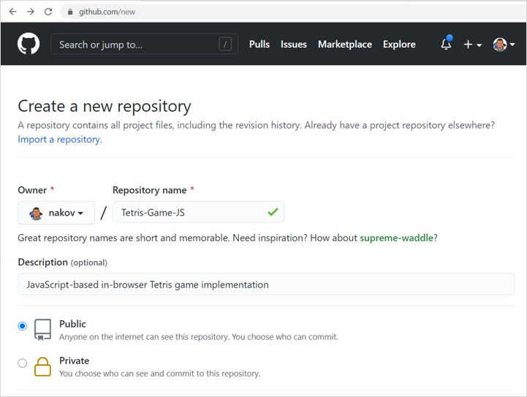
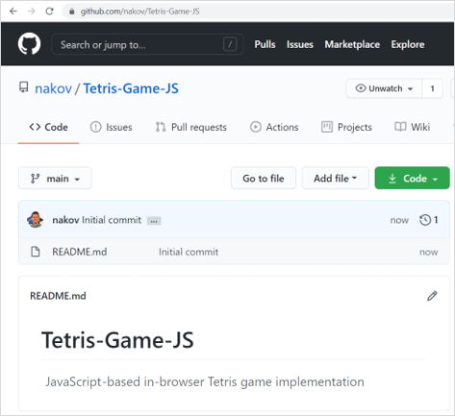
Creating a GitHub Repository

Slide 26
GitHub – Example
Clone a repository from GitHub
Modify local files
Commit changes (local)
Push the changes to GitHub
git clone https://github.com/SoftUni/playground
notepad README.md
git add . & git commit -m "Added something"
git push
Notes:
Let's illustrate how we can use Git and GitHub through a few examples.
We shall clone a GitHub repository, edit a local file, commit the local changes and push them to GitHub.
We work with this sample Git repository: https://github.com/SoftUni/playground
First, let's look at it.
It holds several files: code + documentation.
As a concept, source control repositories hold the source code and other assets of a software project.
We first clone the sample repository to a local directory, using the "git clone" command.
We must have pre-installed the "Git" client software on the local machine.
We start the system console (which is also called "terminal window" or "command prompt").
Then we type the following command at the command line:
git clone https://github.com/SoftUni/playground
This will create a local copy of the specified repository in the "playground" subdirectory in the current directory.
Now we can modify а local file, for example the file "README.md".
We can use a text editor of choice, such as "Notepad".
We can open the file with Notepad by the following command:
notepad README.md
Now add a new line in the file and save it.
Now we have a modified file on the local disk.
We want to commit the pending changes,
so that they enter the local repository and are tracked in the version control system.
We run the following command at the console:
git add . & git commit -m "Added something"
This command adds any new files to the repository and commits all pending changes.
When we commit the changes, we need to leave a message (an explanation of the changes we make).
Now we have a local repository, which holds changes.
We can change files and commit our work many times.
These changes are still not sent to GitHub.
To send the local commits to the remote repository at GitGub, we can execute the following command:
git push
This command needs the current Git user to have permissions to write in the remote repository.
It may ask for username and password or other method of authentication.
Now we can open the repository from the GitHub web site and see the changes:
We can see the content of the changed files.
We can also review the commits (the change log) and what was changed in each commit.
Please focus on the concepts, rather than on the commands and their parameters.
The concepts here are that source control systems keep the source code in a remote repositories,
and we can clone these repositories, edit files, commit the changes and push the commits to the origin repository.
This workflow allows different team members to work together on a shared source code.

Slide 27
GitHub: Live Demo
Create Repo → Edit Files → Checkout → Push

Slide 28

Live Exercises
Creating a Repo, Cloning a Repo, Commit and Push Changes, Resolve Conflicts, Team Interactions

Slide 29

Summary
…
…
…
Use version control systems to work in a team
Keep the shared code in a central repository
Handle merge conflicts with ease
Important Git commands:
clone, add, commit, pull, push
GitHub == the world's most used software project hosting platform
Git repository, issue tracker, Kanban board, Wiki

Slide 30
Questions?
Notes:
30

Slide 31














SoftUni Diamond Partners

Slide 32

Educational Partners

Slide 33
Trainings @ Software University (SoftUni)
Software University – High-Quality Education, Profession and Job for Software Developers
softuni.bg
Software University Foundation
softuni.foundation
Software University @ Facebook
facebook.com/SoftwareUniversity
Software University Forums
forum.softuni.bg
Notes:
33

Slide 34

License
This course (slides, examples, demos, exercises, homework, documents, videos and other assets) is copyrighted content
Unauthorized copy, reproduction or use is illegal
© SoftUni – https://softuni.org
© Software University – https://softuni.bg
Notes:
34

